Slide 1
Knowledge Questions Review
What are they and why do we ask them?

Slide 2
A Definition:
Knowledge questions are questions about knowledge!
What does ‘about knowledge’ mean?

Slide 3
We ask Knowledge Questions when we are not satisfied with accepting everything that everyone tells us
If you find yourself asking ‘How do you know?’ then you are asking Knowledge Questions.

Slide 4
Why do we ask KQ’s?
To get a deeper understanding of what we know and how we know it!

Slide 5
Example:
A: Aliens live in the middle of the Earth.
B: How do you know this?
A: I have faith that they do.
B: But isn’t the content of the middle of the earth a question that can be answered by Natural Science?
A: Maybe, but the sciences also rely on Faith as a way of knowing. Don’t scientists rely on Faith when they tell us what is inside black holes? They can’t exactly see inside black holes or use their sense perception. So isn’t this just Faith?
B: Hmm, I think we may be talking about Faith in a different way. What should the role of Faith be in making claims in Natural Science? KNOWLEDGE QUESTION!!!

Slide 6
Basic
Should Hong Kong adopt a minimum wage?
Deeper
How do we know whether or not wage increases will improve quality of life?
ToK
How reliable are statistics for knowledge in Human Science?
Claim
Hong Kong should adopt a minimum wage.

Slide 7
Basic
Is it morally wrong to engage in homosexual acts.
Deeper
How do we know whether an action is ethical or not?
ToK
To what extent do ethical claims apply across cultures?
Claim
It is wrong to engage in homosexual acts.

Slide 8
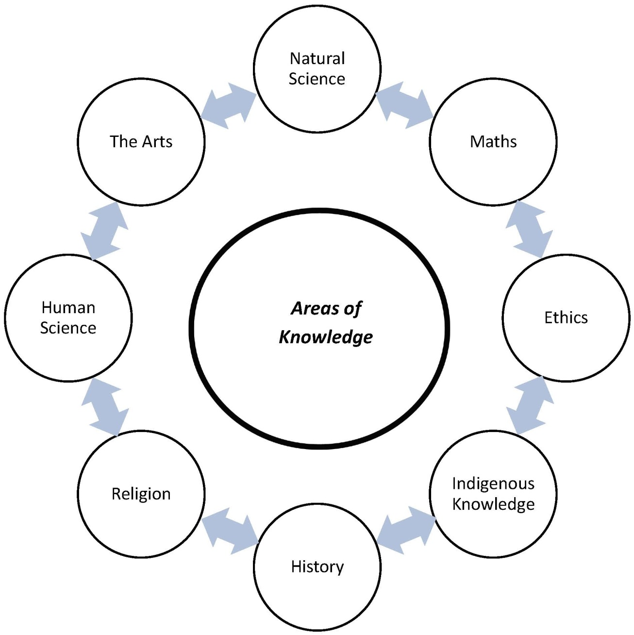

Slide 9
Some insight from Prof. Crow:
“I find the recent TOK Essay May 2014 Question 2 so interesting with regard to KQs: if students can understand the analogy of building & construction, then the idea of KQs should be fairly straightforward to grasp.
Thus, there are various resources that HELP us to build knowledge (the WOKs, notions of truth, testing, evidence and methodology…), but these same resources, just like a builder’s tools, have their limitations and can often HINDER our attempt to build knowledge…”

Slide 10
Prof. Crow continued
“So, a KQ is part of our toolkit that allows us to sharpen up our thinking about knowledge; to focus our enquiry into how the WOKs, for example, help or hinder the construction of knowledge and to develop our arguments and counter claims as part of our investigation into knowledge.
And, just like a master builder, we need to look after our tools so that they’re ready to hand and efficient when we’re exploring how knowledge is constructed. One way in which to do this is to look closely at, and to refine, the language in which we frame our KQs…”

Slide 11
Crow’s take on the differences in phrasing Knowledge Questions:
Consider these questions:
1. Can we trust the senses?
2. When can we trust the senses?
3. Should we trust the senses?
4. To what extent should we trust the senses?
All four questions are forms of KQ, but they are varied in their impact and the quality of enquiry they generate. One at a time…

Slide 12
Crow’s take on the differences in phrasing Knowledge Questions:
1. Can we trust the senses?
“KQs of the first type are fairly ‘weak’. Notice how they start with the verb ‘can’. Questions which start with variations of this verb (‘is’, ‘do’, ‘will’, ‘have’ and so on) are ‘closed’ questions, to which you can usually answer ‘yes’ or ‘no’ without much further informed discussion.”

Slide 13
Crow’s take on the differences in phrasing Knowledge Questions:
2. When can we trust the senses?
“KQs of the second type are sound, but may end up in a more factual discussion of the topic instead of one that questions how knowledge is built. Notice how it starts with one of the 5 Ws, ‘when’.”

Slide 14
Crow’s take on the differences in phrasing Knowledge Questions:
3. Should we trust the senses?
“KQs of the third type are slightly stronger and more ‘open’ in their impact: the verb ‘should’ already introduces an ethical element to our thinking and encourages us to weigh up the strengths and weaknesses of our topic. Alternative starting expressions could be ‘might’, ‘could’, or ‘would’ either alone or in conjunction with one of the 5Ws.”

Slide 15
Last one.
4. To what extent should we trust the senses?
“KQs of the fourth type are perhaps the strongest. Look at the command expression ‘To what extent…’ whose job it is to challenge us not only to explore the scale and depth of knowledge, but also to evaluate the methods of its construction. Other command expressions are ‘In what ways…’ (which allows us to compare and contrast how knowledge is built in different AOKs) and ‘How far…’ (which allows us to enquire into issues related to the limits of knowledge and its implications.)”

Slide 16
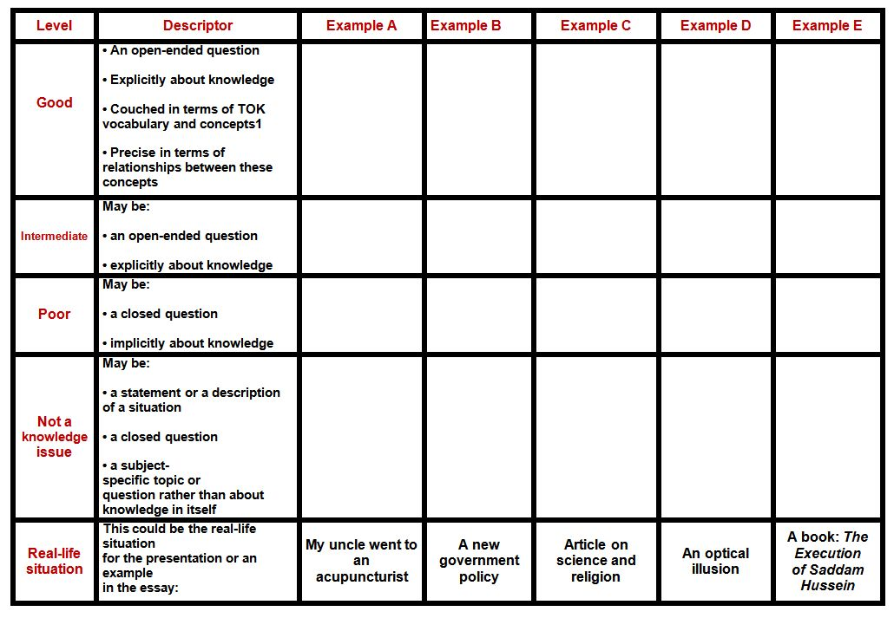
Your Turn:
Exercise with the Knowledge Question table

Slide 17
Summary:
The main questions in TOK are not just ‘How do I know’….
They are more like:
How do we know in Maths?
How do we know in Science?
KQ’s link concepts like WOKs, justification, evidence, culture, perspectives, truth, belief, experience, bias…

Slide 18
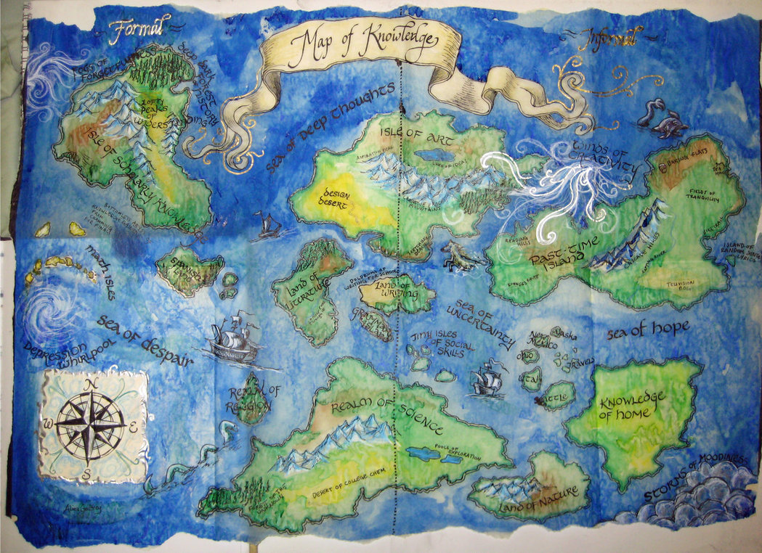
If knowledge is like a map, KQs are the questions we make to investigate the ways these maps are made, their strengths, limitations, boundaries, and similarities..

Slide 19
Reflection and homework:
Create your own Knowledge Question using the blank template

