Slide 1
Model ToK Oral Presentation
Understanding the Vancouver Riots:
a TOK analysis of the violence following the
Stanley Cup Hockey Finals
on June 15^{th,} 2011

Slide 2
Objectives of ToK Oral Presentation
Identify and explore a Knowledge Issue (KI) raised by a Real-life Situation (RLS)
Show insightful thinking about KI, supporting ideas about knowledge claims, justifying thinking, making connections with ToK concepts
Presentation should have two stages:
an introduction and brief explanation of the RLS, and clear identification of KI
Discussion of KI and shows how the KI relates to RLS

Slide 3
Assessment criteria for the Presentation
Criterion A: Identification of the knowledge issue [/5]
Did the student identify a relevant knowledge issue in a real-life situation?
Criterion B: Treatment of knowledge issues [/5]
Did the presentation show a good understanding of the knowledge issues, in the context of real life?
Criterion C: Knower’s perspective [/5]
Did the presentation show an individual approach, particularly in the use of arguments and examples?
Criterion D: Connections [/5]
Did the presentation give a clear account of how the question could be approached from different perspectives?

Slide 4
Tips:
Without a focus on a Knowledge Issue presentations cannot deserve high marks on criteria
The topic should be grounded in real people and real life, not just a theoretical issue
Don’t just mention TOK concepts and vocabulary: Analyze them!
Have notes for your presentation. Practice it.
In groups, make sure each member participates evenly and critically in the presentation
Approach the KI from different viewpoints
Use the TOK presentation planner

Slide 5
5. Apply analysis
back to RLS
6. Extend analysis to other areas
1. Take a RLS
2. Extract a KI
from a RLS
4. While analyzing,
Identify other KI’s
3. Analyze the KI – not the RLS
From your own perspective
From other perspectives
Using ideas and concepts from TOK

Slide 6
1. Take a Real Life Situation
Violence in downtown Vancouver, BC, Canada after the final game of the Stanley Cup between Vancouver Canucks and Boston Bruins
June 15, 2011

Slide 9
News coverage

Slide 10
Summary of RLS
The city of Vancouver set up giant screens so that fans could watch the game
The local team lost
Fans destroyed the screens and rioting began
Store windows were broken and stores looted
Fights broke out between Vancouver supporters
Cars were set on fire, including police cars
Riot police sprayed gas to disperse the crowds
Hundreds of people were injured and arrested
Millions of dollars in damages were reported

Slide 11
Reactions
“How can well behaved sports fans from an advanced and liberal society behave this way?”
Teacher from Vancouver
“So sad watching our VPD cars on fire and how quickly people can turn from law-abiding to law-breaking.”
Vancouver Police Department on Twitter

Slide 12
2. Extract Knowledge Issue
KI = open-ended questions that have more than one possible answer; explicitly about knowledge and not subject-specific claims; worded in TOK vocabulary and concepts:
the Areas of Knowledge: Natural Sciences, Social Sciences, History, Mathematics, Ethics
the Ways of Knowing: Reason, Emotion, Perception, Language
and the Concepts in the linking questions—belief, certainty, culture, evidence, experience, explanation, interpretation, intuition, justification, truth, values
precise in terms of the relationships between these concepts
How do individuals know what is the ethical thing to do when the collective is doing something seemingly wrong?

Slide 13
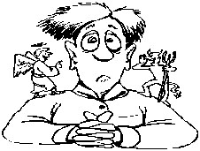
3. Analyze the Knowledge Issue What is the ‘ethical thing to do’?
Do we agree that :
it is wrong to break store windows and steal (looting)?
it is wrong to destroy private property?
It is wrong to fight and beat up others because you are angry?

Slide 14
Yes! But, why? Where does ethical conduct come from? Why is it important to behave ethically?
Ethical codes are sets of rules that control and regulate the way people in a collective should behave
Ethics are more than just rules or laws – they establish principles on which rules are based
Ethical decisions reside in our own consciences

Slide 16
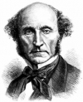
John Stuart Mill’s Utilitarian Theory of Ethics
The right thing to do is not just to ensure your own happiness, but the happiness of the whole society
Actions are right if they benefit the majority of people
We should seek the greatest happiness for the greatest number of people

Slide 17
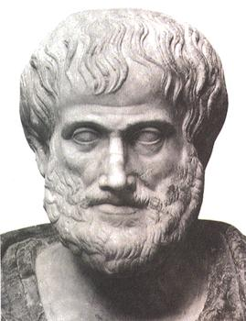
Self-interest Theory of Ethics advanced by Aristotle
We are reasoning, rational beings, so we can differentiate the concepts of right and wrong
To be happy is defined as being content with life in a fulfilled and virtuous way
It is in our self-interest to cultivate virtues like generosity, bravery, temperance, loyalty because in the long-term the practice of these virtues will ensure our happiness

Slide 18
Support for Self-interest Theory
If you steal, you will soon be rejected by the community in which you live
Psychologically-speaking, you respect others because you share the same human nature:
“Other people are of value because they are the same species as yourself.”
Hence, feelings of sympathy and solidarity
You treat others as you would like to be treated (Kant’s ‘categorical imperative’)

Slide 19
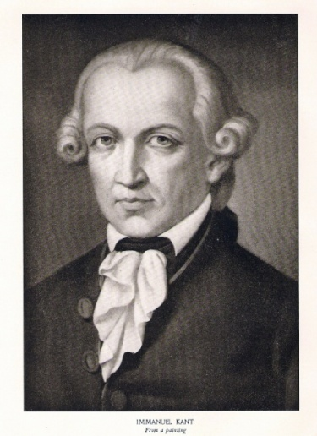
Kant’s ‘Categorical Imperative’
There is a rational, universal explanation for ethical behaviour, transcending cultures
Kant called the supreme principle of morality: Categorical Imperative
We are capable of reason and have ethical responsibilities
As reasoning beings, we can consider what would happen if our actions became a universal rule of conduct. (What would happen if everyone, categorically, did what you did?)
Kant also believed in the Law of Respecting Others
We must all respect others in the same way we expect to be treated
The Law of Respecting Others should be universally applied

Slide 20
Summing up why ethics is important:
For utilitarian purposes, we should behave ethically in order to ensure the greatest happiness for the greatest number of people
For Aristotle, if we behave ethically we ensure our own ‘fulfilled’ and ‘virtuous’ happiness in the long-run
For Kant, we have ethical responsibilities due to the ability to reason: ‘categorical imperative’
For people who rioted in Vancouver, they were not only behaving illegally and stupidly, but also unethically

Slide 21
But! What happens when a social collective seems to act wrongly?
How do we know it is wrong when many people are doing it?
Violent manifestations
Riots
Anti-Jewish Pogroms 1930’s
Food riots
Sports violence

Slide 22
4. Identify other KIs: Psychology of masses
“the madding crowd”
the anonymity of crowds – enthusiasm of a crowd makes an individual less aware of true nature of their actions
Gustave Le Bon, French sociologist (1841-1931)
Behaviour of crowds are based more on emotion than on intellect
Kurt Lewin, German-American psychologist (1890-1947)
Lewin’s Equation: B = f(P,E) means that individual behaviour is a function of Person and their Environment
A violent environment can lead a peaceful individual to behave violently

Slide 23
4. Identify other KIs: Biological explanations
“Herd behaviour”
Crowds which are threatened behave in the same way as herds of animals fleeing a predator
Hamilton’s Selfish Herd theory : under panic conditions humans behave the same way as mice or ants
Role of adrenal gland (adrenaline)
“fight or flight”

Slide 24
5. Apply analysis back to RLS – Observe the ‘Herd Behaviour’!

Slide 25
KI: How do individuals know what is the ethical thing to do when the collective is doing something seemingly wrong?
Our understanding of what are correct individual ethical decisions are learned from school, family and role models in society
However, as Lewin says that an individual behaviour is affected by his or her environment, these ethical or unethical behaviours can be altered by the way a crowd behaves
This can be due to crowd psychology, as Le Bon says that crowds lead to more emotional behaviour, than using one’s reason
This could also be the result of somethinge more innate, a biological instinct to “fight or flight.”
Perceptions of what is just or unjust, appropriate or inappropriate can also be affected by the consumption of alcohol

Slide 26
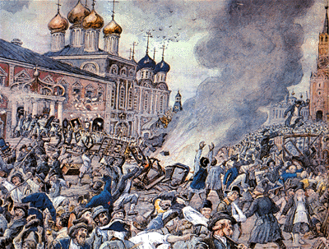
Plague Riot
6. Extend analysis to other areas:
Examples of disruptive crowd behaviour from History
Moscow, 1771

Slide 27
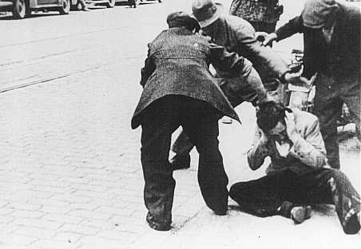
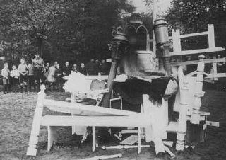
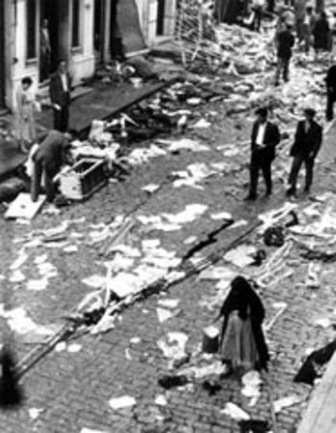
Pogroms
Germany 1930’s

Slide 28
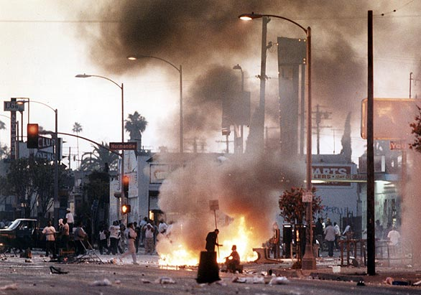
Los Angeles riots 1992

Slide 29
Ethics in the 21st Century
Role of Facebook is influencing social behaviour, removing anonymity of masses
Identifying culprits of violence
Facebook pages such as Facebook Riot Pics: Post Your Photos and Vancouver Riot: Tag the Hooligans have encouraged people to post photos and identify people smashing windows, tipping over urinals and police cars, burning vehicles and brawling with police.

Slide 30
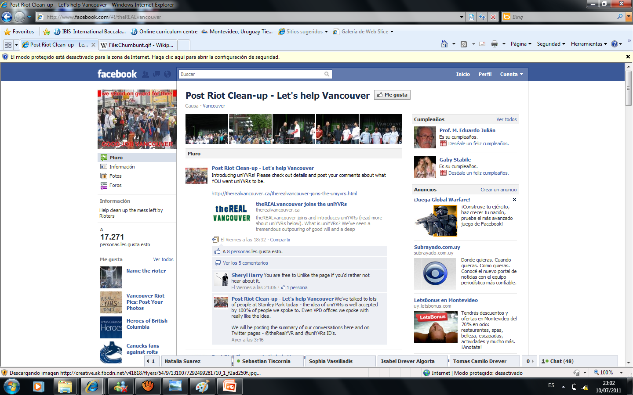
Clean up Vancouver groups

Slide 31
Ethics is thought and action
Plaza del Sol manifestations – Madrid, May 2011
“Democracia real, ya!”
“La clase política vive alejada de los ciudadanos y sólo se maneja por sus propios intereses.”
Manifestations in Egypt – Cairo, January 2011
News: Social networks credited with role in toppling Egypt's Mubarak
Activists used Facebook, Twitter, YouTube to mobilize during protests

Slide 32
Conclusions
Senseless acts of violence by masses have occurred repeatedly in History
Some mass demonstrations and riots do have rational explanations, such as the recent disruptions in Egypt and manifestations in Spain, or the plague riots in Moscow in 18th Century
However, when massive disruptions take place, it can lead people to forget the ethical values learned from parents, schools and positive role models in society
These ethical values form the basis of our conscience and, according to Aristotle, will ensure our long-term happiness and fulfillment
Options will always exist in times of social unrest: how an individual behaves in public will determine his or her understanding of ethics

